Slide 1




SRM
INSTITUTE OF SCIENCE AND TECHNOLOGY,
CHENNAI.
18CSC201J
DATA STRUCTURES AND ALGORITHMS
Unit- V

Slide 2

SRM
INSTITUTE OF SCIENCE AND TECHNOLOGY,
CHENNAI.
GRAPH TERMINOLOGY
GRAPH TRAVERSAL

Slide 3
SRM
INSTITUTE OF SCIENCE AND TECHNOLOGY,
CHENNAI.
A graph - an abstract data structure that is used to implement the graph concept from mathematics.
A collection of vertices (also called nodes) and edges that connect these vertices.
A graph is often viewed as a generalization of the tree structure, where instead of a having a purely parent-to-child relationship between tree nodes.
Any kind of complex relationships between the nodes can be represented.

Slide 4
SRM
INSTITUTE OF SCIENCE AND TECHNOLOGY,
CHENNAI.
Why graphs are useful?
Graphs are widely used to model any situation where entities or things are related to each other in pairs; for example, the following information can be represented by graphs:
Family trees in which the member nodes have an edge from parent to each of their children.
Transportation networks in which nodes are airports, intersections, ports, etc. The edges can be airline flights, one-way roads, shipping routes, etc.

Slide 5
SRM
INSTITUTE OF SCIENCE AND TECHNOLOGY,
CHENNAI.
Definition
A graph G is defined as an ordered set (V, E), where V(G) represent the set of vertices and E(G) represents the edges that connect the vertices.
The figure given shows a graph with V(G) = { A, B, C, D and E} and E(G) = { (A, B), (B, C), (A, D), (B, D), (D, E), (C, E) }. Note that there are 5 vertices or nodes and 6 edges in the graph.
Fig:a
Definition
A
B
C
D
E

Slide 6
SRM
INSTITUTE OF SCIENCE AND TECHNOLOGY,
CHENNAI.
A graph can be directed (Fig a)or undirected (Fig b).
Fig:a
Fig:bDefinition
A
B
C
D
E
A
B
C
D
E

Slide 7
SRM
INSTITUTE OF SCIENCE AND TECHNOLOGY,
CHENNAI.
Graph Terminology:
Adjacent Nodes or Neighbors:
For every edge, e = (u, v) that connects nodes u and v; the nodes u and v are the end-points and are said to be the adjacent nodes or neighbors.
Degree of a node:
Degree of a node u, deg(u), is the total number of edges containing the node u. If deg(u) = 0, it means that u does not belong to any edge and such a node is known as an isolated node.

Slide 8
SRM
INSTITUTE OF SCIENCE AND TECHNOLOGY,
CHENNAI.
Regular graph: Regular graph is a graph where each vertex has the same number of neighbors. That is every node has the same degree. A regular graph with vertices of degree k is called a k‑regular graph or regular graph of degree k.
O regular graph | 1 regular graph | 2 regular graph

Slide 9
SRM
INSTITUTE OF SCIENCE AND TECHNOLOGY,
CHENNAI.
Path: A path P, written as P = {v0, v1, v2,….., vn), of length n from a node u to v is defined as a sequence of (n+1) nodes. Here, u = v0, v = vn and vi-1 is adjacent to vi for i = 1, 2, 3, …, n.
Closed path: A path P is known as a closed path if the edge has the same end-points. That is, if v0 = vn.
Simple path: A path P is known as a simple path if all the nodes in the path are distinct with an exception that v0 may be equal to vn. If v0 = vn, then the path is called a closed simple path.
Cycle: A closed simple path with length 3 or more is known as a cycle. A cycle of length k is called a k – cycle.

Slide 10
SRM
INSTITUTE OF SCIENCE AND TECHNOLOGY,
CHENNAI.
Connected graph: A graph in which there exists a path between any two of its nodes is called a connected graph. That is to say that there are no isolated nodes in a connected graph. A connected graph that does not have any cycle is called a tree.
Complete graph: A graph G is said to be a complete, if all its nodes are fully connected, that is, there is a path from one node to every other node in the graph. A complete graph has n(n-1)/2 edges, where n is the number of nodes in G.

Slide 11
SRM
INSTITUTE OF SCIENCE AND TECHNOLOGY,
CHENNAI.
Labeled graph or weighted graph: A graph is said to be labeled if every edge in the graph is assigned some data. In a weighted graph, the edges of the graph are assigned some weight or length. Weight of the edge, denoted by w(e) is a positive value which indicates the cost of traversing the edge.
Multiple edges: Distinct edges which connect the same end points are called multiple edges. That is, e = {u, v) and e’ = (u, v) are known as multiple edges of G.
Loop: An edge that has identical end-points is called a loop. That is, e = (u, u).
Multi- graph: A graph with multiple edges and/or a loop is called a multi-graph.
Size of the graph: The size of a graph is the total number of edges in it.

Slide 12
SRM
INSTITUTE OF SCIENCE AND TECHNOLOGY,
CHENNAI.
(a) Multi-graph | (b) Tree | (c) Weighted Graph
e1
3
4
A
B
e4
A
B
C
A
B
C
e2
e3
2
7
1
C
e6
D
E
F
e5
e7
D
B
3

Slide 13
SRM
INSTITUTE OF SCIENCE AND TECHNOLOGY,
CHENNAI.
Directed Graph:
A directed graph G, also known as a digraph, is a graph in which every edge has a direction assigned to it. An edge of a directed graph is given as an ordered pair (u, v) of nodes in G. For an edge (u, v)-
The edge begins at u and terminates at v
U is known as the origin or initial point of e. Correspondingly, v is known as the destination or terminal point of e
U is the predecessor of v. Correspondingly, v is the successor of u
nodes u and v are adjacent to each other.

Slide 14
SRM
INSTITUTE OF SCIENCE AND TECHNOLOGY,
CHENNAI.
Terminologies in Directed graph:
Out-degree of a node: The out degree of a node u, written as outdeg(u), is the number of edges that originate at u.
In-degree of a node: The in degree of a node u, written as indeg(u), is the number of edges that terminate at u.
Degree of a node: Degree of a node written as deg(u) is equal to the sum of in-degree and out-degree of that node. Therefore, deg(u) = indeg(u) + outdeg(u)
Source: A node u is known as a source if it has a positive out-degree but an in-degree = 0.
Sink: A node u is known as a sink if it has a positive in degree but a zero out-degree.
Reachability: A node v is said to be reachable from node u, if and only if there exists a (directed) path from node u to node v.

Slide 15
SRM
INSTITUTE OF SCIENCE AND TECHNOLOGY,
CHENNAI.
Strongly connected directed graph: A digraph is said to be strongly connected if and only if there exists a path from every pair of nodes in G. That is, if there is a path from node u to v, then there must be a path from node v to u.
Unilaterally connected graph: A digraph is said to be unilaterally connected if there exists a path from any pair of nodes u, v in G such that there is a path from u to v or a path from v to u but not both.
Parallel/Multiple edges: Distinct edges which connect the same end points are called multiple edges. That is, e = {u, v) and e’ = (u, v) are known as multiple edges of G.
Simple directed graph: A directed graph G is said to be a simple directed graph if and only if it has no parallel edges. However, a simple directed graph may contain cycle with an exception that it cannot have more than one loop at a given node

Slide 16
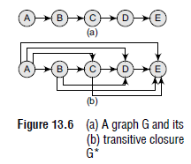
SRM
INSTITUTE OF SCIENCE AND TECHNOLOGY,
CHENNAI.
Transitive Closure of a Directed Graph:
It is same as the adjacency list in graph terminology.
It is stored as a matrix T.
Definition
For a directed graph G = (V,E), where V is the set of vertices and E is the set of edges, the transitive closure of G is a graph G* = (V,E*). In G*, for every vertex pair v, w in V there is an edge (v, w) in E* if and only if there is a valid path from v to w in G.

Slide 17
SRM
INSTITUTE OF SCIENCE AND TECHNOLOGY,
CHENNAI.
A binary relation indicates only whether the node A is connected to node B, whether node B is connected to node C, etc.
But once the transitive closure is constructed as shown in Fig.
we can easily determine in O(1) time whether node E is reachable from node A or not.

Slide 18
SRM
INSTITUTE OF SCIENCE AND TECHNOLOGY,
CHENNAI.
Definition
For a directed graph G = (V,E), where V is the set of vertices and E is the set of edges, the transitive closure of G is a graph G* = (V,E*). In G*, for every vertex pair v, w in V there is an edge (v, w) in E* if and only if there is a valid path from v to w in G.
A binary relation indicates only whether the node A is connected to node B, whether node B is connected to node C, etc. But once the transitive closure is constructed as shown in Fig. we can easily determine in O(1) time whether node E is reachable from node A or not.

Slide 19
SRM
INSTITUTE OF SCIENCE AND TECHNOLOGY,
CHENNAI.
Graph Representation:
There are three common ways of storing graphs in the computer’s memory.
They are:
Sequential representation by using an adjacency matrix.
Linked representation by using an adjacency list that stores the neighbors of a node using a linked list.
Adjacency multi-list which is an extension of linked representation.

Slide 20
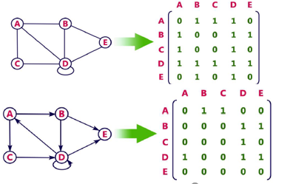
SRM
INSTITUTE OF SCIENCE AND TECHNOLOGY,
CHENNAI.
Adjacency Matrix Representation:
An adjacency matrix is used to represent which nodes are adjacent to one another. By definition, two nodes are said to be adjacent if there is an edge connecting them.
In this representation, graph can be represented using a matrix of size V*V.
No matter how few edges the graph has, the matrix has O(n^2) in memory.

Slide 21
SRM
INSTITUTE OF SCIENCE AND TECHNOLOGY,
CHENNAI.
Adjacency List Representation:
An adjacency list is another way in which graphs can be represented in the computer’s memory.
This structure consists of a list of all nodes in G. Furthermore, every node is in turn linked to its own list that contains the names of all other nodes that are adjacent to it.
The key advantages of using an adjacency list are:
It is easy to follow and clearly shows the adjacent nodes of a particular node.
It is often used for storing graphs that have a small-to-moderate number of edges. That is, an adjacency list is preferred for representing sparse graphs in the computer’s memory; otherwise, an adjacency matrix is a good choice.
Adding new nodes in G is easy and straightforward when G is represented using an adjacency list. Adding new nodes in an adjacency matrix is a difficult task, as the size of the matrix needs to be changed and existing nodes may have to be reordered.

Slide 22
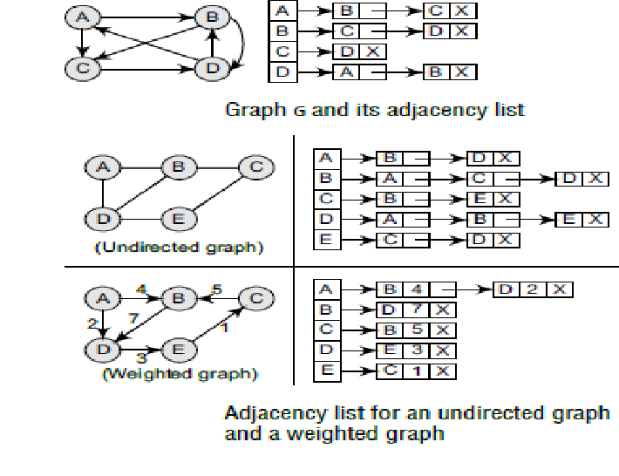
SRM
INSTITUTE OF SCIENCE AND TECHNOLOGY,
CHENNAI.
Adjacency List Representation:

Slide 23
SRM
INSTITUTE OF SCIENCE AND TECHNOLOGY,
CHENNAI.
Adjacency Multi-list Representation:
Graphs can also be represented using multi-lists which can be said to be modified version of adjacency lists.
Adjacency multi-list is an edge-based rather than a vertex-based representation of graphs.
A multi-list representation basically consists of two parts—
a directory of nodes’ information and a set of linked lists storing information about edges.
While there is a single entry for each node in the node directory, every node, on the other hand, appears in two adjacency lists (one for the node at each end of the edge).
For example, the directory entry for node i points to the adjacency list for node i. This means that the nodes are shared among several lists.

Slide 24
SRM
INSTITUTE OF SCIENCE AND TECHNOLOGY,
CHENNAI.
In a multi-list representation, the information about an edge (vi, vj) of an undirected graph can be stored using the following attributes:
M: A single bit field to indicate whether the edge has been examined or not.
vi: A vertex in the graph that is connected to vertex vj by an edge.
vj: A vertex in the graph that is connected to vertex vi by an edge.
Link i for vi: A link that points to another node that has an edge incident on vi.
Link j for vi: A link that points to another node that has an edge incident on vj.

Slide 25
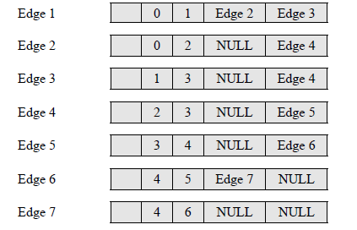
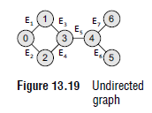
SRM
INSTITUTE OF SCIENCE AND TECHNOLOGY,
CHENNAI.
Adjacency Multi-list Representation:
Consider the undirected graph given in Fig. The adjacency multi-list for the graph can be given as:

Slide 26
SRM
INSTITUTE OF SCIENCE AND TECHNOLOGY,
CHENNAI.
GRAPH TRAVERSAL ALGORITHMS:
This technique is used for searching a vertex in a graph.
It is also used to decide the order of vertices to be visit in the search process.
There are two standard methods of graph traversal:
1. Breadth-first search
2. Depth-first search
While breadth-first search uses a queue as an auxiliary data structure to store nodes for further processing.
The depth-first search scheme uses a stack.

Slide 27
SRM
INSTITUTE OF SCIENCE AND TECHNOLOGY,
CHENNAI.
Breadth-First Search Algorithm:
It is a graph search algorithm that begins at the root node and explores all the neighboring nodes.
Then for each of those nearest nodes, the algorithm explores their unexplored neighbor nodes, and so on, until it finds the goal.
This technique is used for searching a vertex in a graph.
It produces a spanning tree as a final result.
Spanning tree is a graph without any loops.
Here we use Queue data structure with maximum size of total number of vertices in the graph.

Slide 28
SRM
INSTITUTE OF SCIENCE AND TECHNOLOGY,
CHENNAI.
Breadth-First Search Algorithm:
STEPS:
Step 1 - Define a Queue of size total number of vertices in the graph.
Step 2 - Select any vertex as starting point for traversal. Visit that vertex and insert it into the Queue.
Step 3 - Visit all the non-visited adjacent vertices of the vertex which is at front of the Queue and insert them into the Queue.
Step 4 - When there is no new vertex to be visited from the vertex which is at front of the Queue then delete that vertex.
Step 5 - Repeat steps 3 and 4 until queue becomes empty.
Step 6 - When queue becomes empty, then produce final spanning tree by removing unused edges from the graph

Slide 29
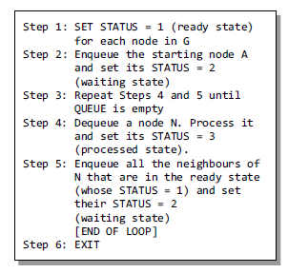
SRM
INSTITUTE OF SCIENCE AND TECHNOLOGY,
CHENNAI.
Breadth-First Search Algorithm:

Slide 30
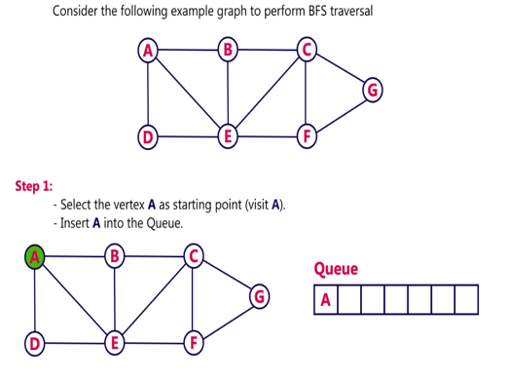
SRM
INSTITUTE OF SCIENCE AND TECHNOLOGY,
CHENNAI.
Breadth-First Search Algorithm:

Slide 31
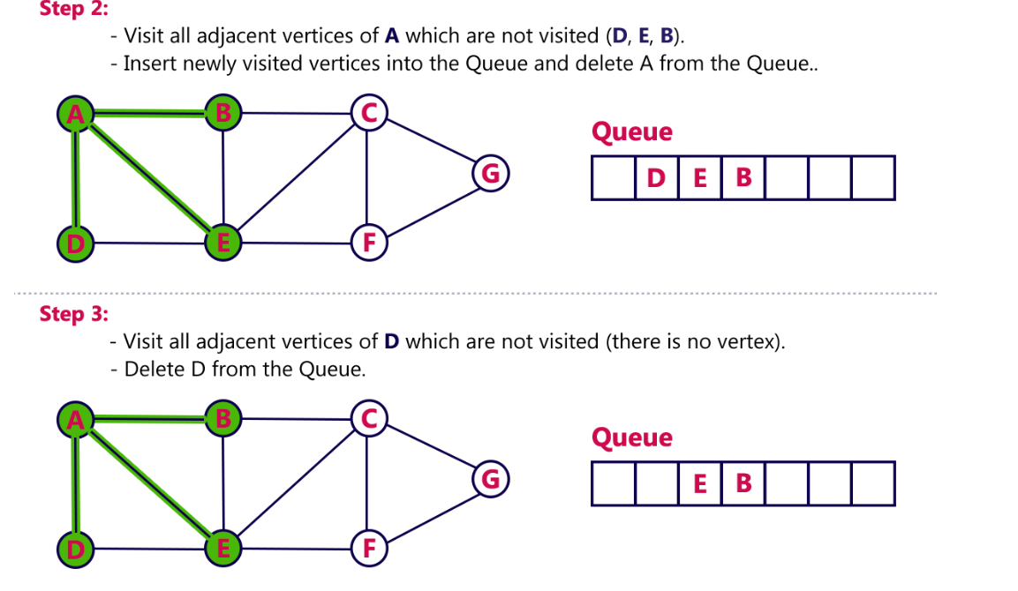
SRM
INSTITUTE OF SCIENCE AND TECHNOLOGY,
CHENNAI.
Breadth-First Search Algorithm:

Slide 32
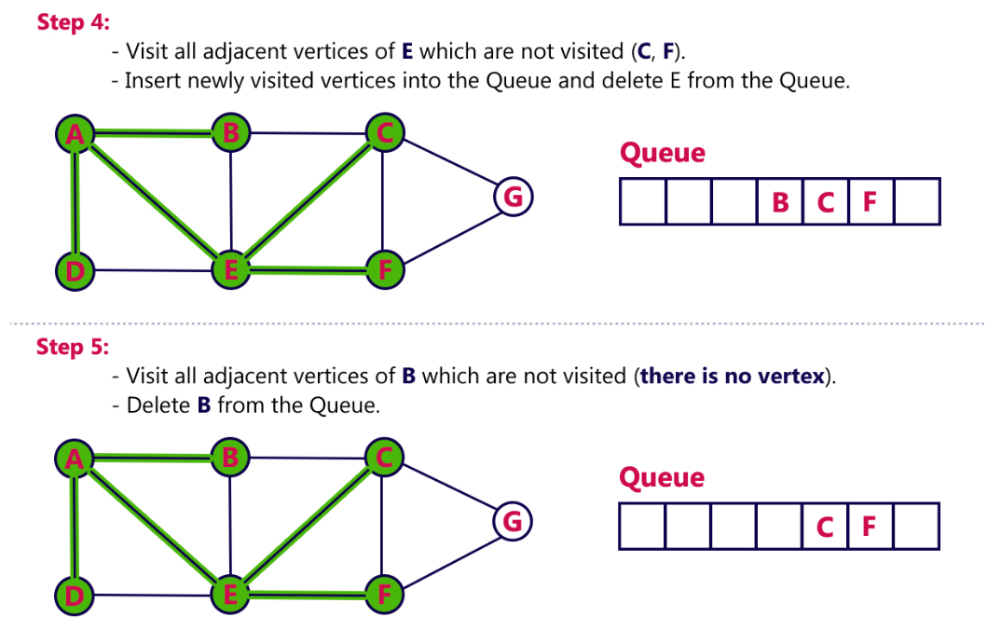
SRM
INSTITUTE OF SCIENCE AND TECHNOLOGY,
CHENNAI.
Breadth-First Search Algorithm:

Slide 33
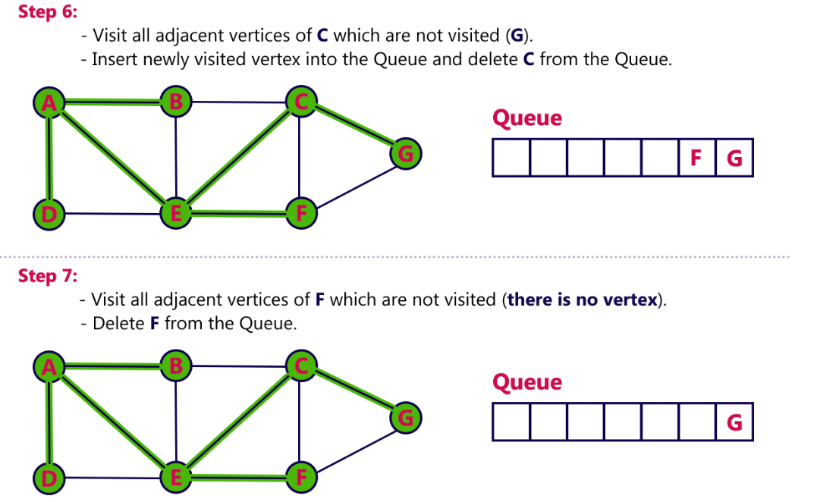
SRM
INSTITUTE OF SCIENCE AND TECHNOLOGY,
CHENNAI.
Breadth-First Search Algorithm:

Slide 34
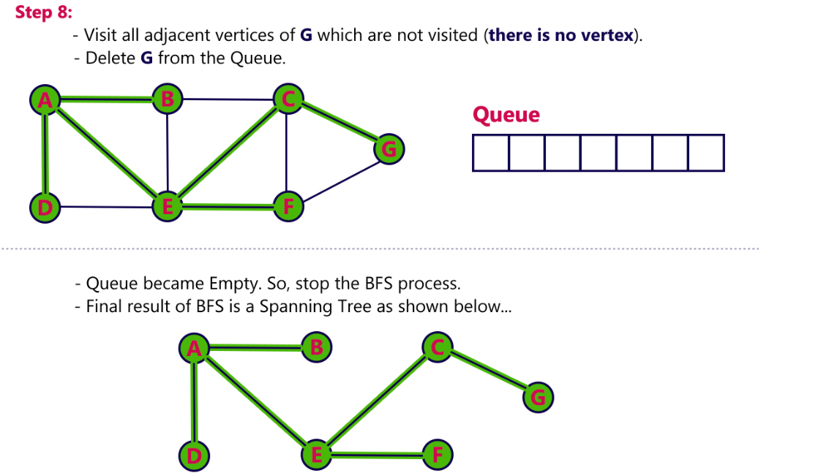
SRM
INSTITUTE OF SCIENCE AND TECHNOLOGY,
CHENNAI.
Breadth-First Search Algorithm:

Slide 35
SRM
INSTITUTE OF SCIENCE AND TECHNOLOGY,
CHENNAI.
Features of Breadth-First Search Algorithm:
Space complexity
In the breadth-first search algorithm, all the nodes at a particular level must be saved until their child nodes in the next level have been generated.
The space complexity is therefore proportional to the number of nodes at the deepest level of the graph. Given a graph with branching factor b (number of children at each node) and depth d, the asymptotic space complexity is the number of nodes at the deepest level O(bd).
Time complexity
In the worst case, breadth-first search has to traverse through all paths to all possible nodes, thus the time complexity of this algorithm asymptotically approaches O(bd).
However, the time complexity can also be expressed as O( | E | + | V | ), since every vertex and every edge will be explored in the worst case.

Slide 36
SRM
INSTITUTE OF SCIENCE AND TECHNOLOGY,
CHENNAI.
Completeness
Breadth-first search is said to be a complete algorithm because if there is a solution, breadth-first search will find it regardless of the kind of graph.
But in case of an infinite graph where there is no possible solution, it will diverge.
Optimality
Breadth-first search is optimal for a graph that has edges of equal length, since it always returns the result with the fewest edges between the start node and the goal node.
But generally, in real-world applications, we have weighted graphs that have costs associated with each edge, so the goal next to the start does not have to be the cheapest goal available.

Slide 37
SRM
INSTITUTE OF SCIENCE AND TECHNOLOGY,
CHENNAI.
Applications of Breadth-First Search Algorithm:
Breadth-first search can be used to solve many problems such as:
Finding all connected components in a graph G.
Finding all nodes within an individual connected component.
Finding the shortest path between two nodes, u and v, of an unweighted graph.
Finding the shortest path between two nodes, u and v, of a weighted graph.

Slide 38
SRM
INSTITUTE OF SCIENCE AND TECHNOLOGY,
CHENNAI.
Depth-first Search Algorithm:
The depth-first search algorithm progresses by expanding the starting node of G and then going deeper and deeper until the goal node is found, or until a node that has no children is encountered. When a dead-end is reached, the algorithm backtracks, returning to the most recent node that has not been completely explored.
In other words, depth-first search begins at a starting node A which becomes the current node. Then, it examines each node N along a path P which begins at A. That is, we process a neighbor of A, then a neighbor of neighbor of A, and so on.

Slide 39
SRM
INSTITUTE OF SCIENCE AND TECHNOLOGY,
CHENNAI.
Depth-first Search Algorithm:
During the execution of the algorithm, if we reach a path that has a node N that has already been processed, then we backtrack to the current node. Otherwise, the unvisited (unprocessed) node becomes the current node.
This technique is used for searching a vertex in a graph.
It produces a spanning tree as a final result.
Spanning tree is a graph without any loops.
Here we use Stack data structure with maximum size of total number of vertices in the graph.

Slide 40
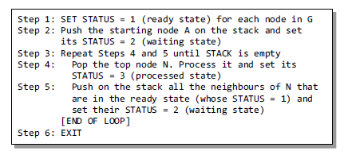
SRM
INSTITUTE OF SCIENCE AND TECHNOLOGY,
CHENNAI.
Depth-first Search Algorithm:

Slide 41
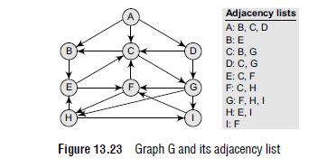
SRM
INSTITUTE OF SCIENCE AND TECHNOLOGY,
CHENNAI.
Depth-first Search Algorithm:
Consider the graph and find the spanning tree,

Slide 42
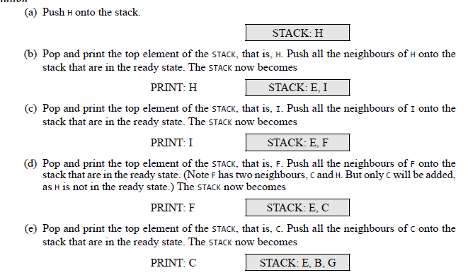
SRM
INSTITUTE OF SCIENCE AND TECHNOLOGY,
CHENNAI.
Depth-first Search Algorithm:

Slide 43
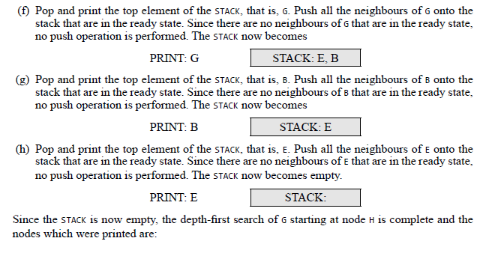

SRM
INSTITUTE OF SCIENCE AND TECHNOLOGY,
CHENNAI.
Depth-first Search Algorithm:

Slide 44
SRM
INSTITUTE OF SCIENCE AND TECHNOLOGY,
CHENNAI.
Features of Depth-First Search Algorithm
Space complexity The space complexity of a depth-first search is lower than that of a breadthfirst
search.
Time complexity The time complexity of a depth-first search is proportional to the number of
vertices plus the number of edges in the graphs that are traversed. The time complexity can be
given as (O(|V| + |E|)).
Completeness Depth-first search is said to be a complete algorithm. If there is a solution, depthfirst search will find it regardless of the kind of graph. But in case of an infinite graph, where there is no possible solution, it will diverge.

Slide 45
SRM
INSTITUTE OF SCIENCE AND TECHNOLOGY,
CHENNAI.
Applications of Depth-First Search Algorithm
Depth-first search is useful for:
Finding a path between two specified nodes, u and v, of an unweighted graph.
Finding a path between two specified nodes, u and v, of a weighted graph.
Finding whether a graph is connected or not.
Computing the spanning tree of a connected graph.

Slide 46
References: ReemaThareja, “Data Structures Using C”, Oxford Higher Education , First Edition, 2011

